Slide 1



Salesian Youth Ministry –
Four Dimensions
Dimensions of Youth Ministry

Slide 2




Salesian Youth Ministry –
Four Dimensions
A ‘SCHOOL’ that Educates
Jesus increased in ‘WISDOM’
A ‘HOME’ that Nurtures
INTELLECTUAL: ‘MIND’
Jesus increased in ‘STATURE’
PHYSICAL: ‘BODY’
A ‘CHURCH’ that Evangelizes
Jesus increased in ‘FAVOUR WITH GOD’
SPIRITUAL: ‘SOUL’
A ‘PLAYGROUND where friends meet
Jesus increased in ‘FAVOUR WITH PEOPLE’
SOCIAL: ‘HEART’

Slide 3
Salesian Youth Ministry
Four Dimensions
Education to Faith
Social Experience
Educational and Cultural
Vocational

Slide 4
Salesian Youth Ministry
Four Dimensions
Dimensions are the core elements of the Salesian education and ministry. They do not have physical form of their own. They always make their interventions in the physical spaces (Sectors) to provide a Salesian identity. They are the Soul of our ministry. They make all our ministry “Salesian”. Void of Dimensions Sectors lose their unique Salesian identity.
Primary task of the Dimensions is to ANIMATE – from Latin origin ANIMA means Soul, Life. The Soul provides the body 3 things –
gives identity, gives unity & gives dynamism.

Slide 5

Salesian Youth Ministry
Four Dimensions
Evangelising is the first & fundamental purpose of our mission (R. 7, 13). Our project is aimed decisively at young people reaching full maturity in Christ (C. 31) and their growth in the Church, ensuring that education of the religious dimension is central to personal development (GC23, no. 160)
Salesian catechesis does not happen as the end-point of a preparatory course but is implicitly at the heart of initial encounters and explicitly part of everything we offer.
If catechesis is not offered as an integral part of life, it remains foreign and incomprehensible to the young.
Education
to Faith

Slide 6



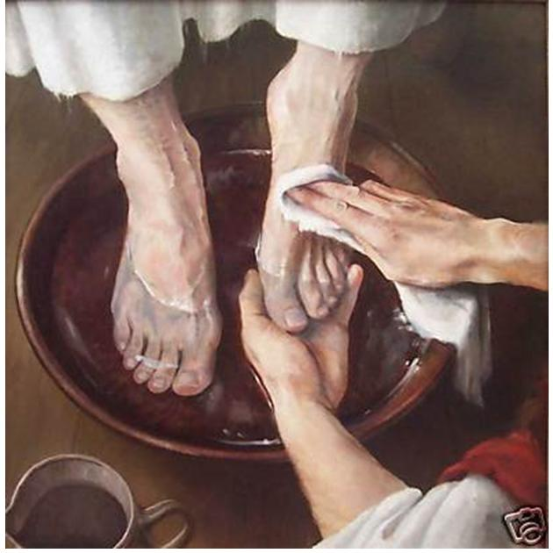
Salesian Youth Ministry
Four Dimensions
1. Development of People’s Religious dimension
Education
to
Faith
2. Integrating Faith & Life
3. Participating Actively and Consciously in Liturgy
4. Promote Practices that ‘Lead to Inwardness’
5. Expressed in Service and Apostolic Involvement

Slide 7


Salesian Youth Ministry
Four Dimensions
Educational
And Cultural
This dimension is intimately related to Education to Faith. Education is the place & also the means for offering the Good News of the Gospel. Education requires that we begin from where young people are really at.
Pastoral outlook is not directed exclusively with faith. It is open to all of experiences; growth, building lives together with others, fitting into society, work. It develops an approach to life where everything is lived with educational wisdom guided by faith.

Slide 8




Salesian Youth Ministry
Four Dimensions
1. Helping Young People to Build a Strong Identity
Educational
and
Cultural
2. Emotional and Affective Maturity
3. Culture Inspired by Christian Humanism
4. Human Development and Professional Competence
5. Reflect on the Reasonableness of their Faith

Slide 9
Salesian Youth Ministry
Four Dimensions
5
Aware of self limitations & grandeur of Universe
Approach religion with faith & reason
Openness & respect to all religions
Fit into the working world
Form attitudes – self confidence, responsibility
4
Understand/promote/respond to emotions
Settings to display emotions & affection
Families to assist
Accommodate desires & limitations
Accompany at stages of emotional life
3
Appreciate the good in culture
Foster culture of life
Culture of solidarity & involvement
Gospel mentality
2
1
Moral/ethical conscience Face & respond to challenges
Value/virtue system Be real life models like Good Shepherd
1

Slide 10
Salesian Youth Ministry
In the Sectors
1. Continuous critical attention is given to the phenomena of culture, work and social communication
EnC
2. Encourages an appropriate pedagogy and a planned educational activity
3. Contextualises the Salesian charism in response to the needs of the national higher education system
4. Animation as an educational option which is realised through the active presence of educators among the young
5. Personal accompaniment sensitive to their deepest desires: reason, affectivity and the search for god

Slide 11

Salesian Youth Ministry
Four Dimensions
Social Experience
Through this dimension a healthy and positive environment is promoted that facilitates coming together of the youth into groups and movements C.35

Slide 12




Salesian Youth Ministry
Four Dimensions
1. Building up a ‘Family Environment’
Social Experience
2. ‘Group Experience’ as a Privileged Setting
3. Educating with the Heart & Style of Animation
4. Being part of Social and Ecclesial Movements
5. Creating a Community of Young Adults

Slide 13
5
Social Experience
Salesian Youth Ministry
Creating community of young adults
4
Four Dimensions
Active involvement & responsibility
in society & Church
3
Recognise as capable of inner processes
Look at positive & potential
Liberating & genuine relationship
Restore to joy of living & courage to hope
2
Many possibilities & settings
Groups intent on Christian commitment
Preparing & forming leaders/educators
Experiences of shared life (retreat, camps)
EPC to effectiveness of groups
1
Atmosphere of personal relationship & shared joy
Notes:
© Copyright PresentationGO.com – The free PowerPoint and Google Slides template library

Slide 14

Salesian Youth Ministry
Four Dimensions
How to Promote?
Soc.Exp
Build, facilitate, promote… groups
Encourage & Entertain interpersonal activities
Exposure to social realities & living
Appreciate & Approve group initiatives
Introduce various Movements, Associations, Clubs…
Animate the Leaders/Animators/Members with various elements pertinent to life and SDB Movement

Slide 15


Social Communication Dimensions

Slide 16

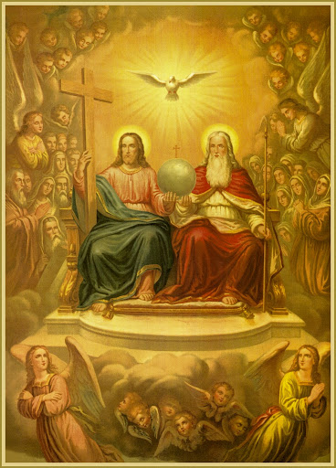
Social Communication:
God has communicated with humanity through the incarnation of the Word: “The Word became flesh and dwelt among us "(John 1:14)
Jesus Christ, incarnate Word, Good Shepherd, communicator of God’s project – Beatitudes
The Trinity is the model of community and shared communication.
The Salesian Constitutions give importance to the fact that communication is a charismatic dimension of the Salesian mission. For the Salesians, to evangelize is to communicate; to educate is to communicate.

Slide 17

Social Communication:
Communication is at the service of the Salesian charism and mission. Therefore, communication works in synergy and collaboration with youth and missionary ministry, vocational and formation ministry.
The digital world always requires continuous updating by everyone. The ability to interpret the cultural and social reality in which Salesians work and to use new technologies to respond to these needs is part of the dynamism of the Salesian charism. As Don Bosco used to say: "Walk with the times".
The United Nations Convention on the Rights of the Child recognizes the importance of the media in children’s and young people’s development. The media is seen as playing a crucial role in shaping societal attitudes towards children’s rights, equipping children with information central to their wellbeing in a child-friendly environment, and soliciting youth’s views on matters that affect them.

Slide 18

Social Communication:
Objectives:
The following are the major objectives that we set out to achieve;
  1. Creating critical awareness of the media influence on individuals and society
  2. Understanding the nature and operation of the media industry as well as the characteristics of each medium
  3. Developing media analytical skills
  4. Enabling critical appreciation of the media
  5. Promoting learning through the media
  6. Empowering with media skills
  7. Fostering creative expression
  8. Practicing media ethics
  9. Applying constructively what is learned from the media domain to everyday life
  10. Identifying and addressing various digital addiction issues

Slide 19


SOCIAL ACTION DIMENSION

Slide 20

SOCIAL ACTION DIMENSION VISION
“To empower the powerless to become worthy of their entitlements by engaging them as partners in the journey towards
self-realization and in creating a just and equitable society.”

Slide 21
SOCIAL ACTION MISSION
To raise Socio-Politico and Cultural consciousness.
To create social awareness and to provide professional assistance.
To form young leaders with enhanced social perception to become catalyst of social change.

Slide 22
To explore possibilities for social entrepreneurial initiatives for rural young people for their sustainable development.
To setup research and development desk and take up researches and present the findings to the province to plan youth pastoral interventions.
To setup research and development desk and take up researches and present the findings to the province to plan youth pastoral interventions.

Slide 23


Salesian Youth Ministry
Four Dimensions
All ministry, especially youth ministry, is radically vocational in nature: it is source & the fruit. Therefore, abandon the reductive notion of vocational ministry – concerned with looking for candidates for religious or priestly life. On the contrary, create appropriate circumstances to discover, take up and responsibly follow vocation.
Create an environment which experiences and passes on a true culture of vocation, conceive of tackle life as a freely received gift; gift to be shared in the service of the fullness for everyone, overcoming an individualistic, consumeristic, relativist mentality & a culture of self-fulfillment.
Fr. Pascual Chavez, AGC 409
Voca

Slide 24




Salesian Youth Ministry
Four Dimensions
1. Accompanying to Formulate their ‘Plan of Life’
Vocational
2. Building a Community of ‘Visible &Credible’ Believers
3. Personal Accompaniment of their ‘Vocational Choices’
4. Making the ‘Vocational’ Dimension Explicit
5. Animating a Culture of ‘Apostolic’ Vocations

Slide 25
Salesian Youth Ministry
1. Concreteness: (seen, remembered, appreciated, evaluated and verified)
Four Dimensions
2. Symbol: (expressed through ritual and gestures)
Methodological
Criteria: A proactive style
3. Narrative: ( Real stories inspire… the story of our faith journey)
4. Internalization: ( valued in head, heart, hand…. Leading to change and new choices)
5. Experience: ( start from experience, return to experience)
6. Participation and taking Responsibility ( young people are the subject of their own lives…)
7. Personalization and Social Development( Growth takes place through relationships…. Yet we need to help each one in their personal growth

Slide 26





Salesian Youth SPIRITUALITY:
Doing our DAILY DUTIES
extraordinarily
Celebrating Life in JOY
& OPTIMISM
Friendship & Personal
Relationship with Christ
Ecclesial COMMUNION &
DEVOTION
SOCIAL & POLITICAL
COMMITMENT

Slide 27


