Slide 1

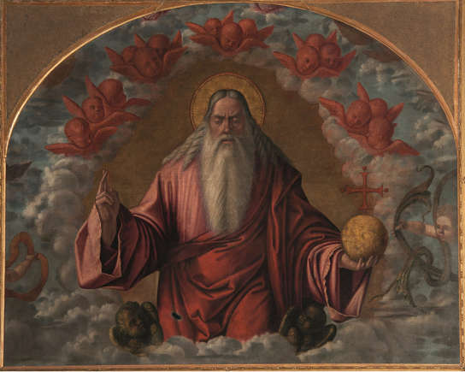
Divine Attributes
According to the Bible
Notes:
God has many attributes, some of which we are familiar with. For instance, most of us know that, according to the Bible, God is the creator. We also know that he knows everything, sees everything, and is everywhere, making him omnipotent and omnipresent. But the Bible mentions many other characteristics that some of us might not know about. For instance, did you know that God is jealous?
In this gallery, you'll find a list of God's attributes, according to the Bible. Click on to get to know them.

Slide 2
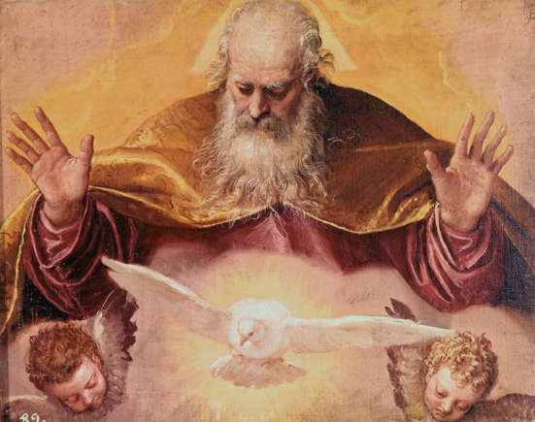
God is sovereign
God’s sovereignty is undisputed for believers. He is the creator and exercises his rule as such. God is king and controls everything.
1 Chronicles 29:11-12
Notes:
God’s sovereignty is undisputed for believers. He is the creator and exercises his rule as such. God is king and controls everything.
This concept is emphasized in 1 Chronicles 29:11-12, which reads: “Yours, O Lord, is the greatness, the power and the glory, the victory and the majesty; for all that is in heaven and in earth is Yours; Yours is the kingdom, O Lord, and You are exalted as head over all. Both riches and honor come from You, and You reign over all. In Your hand is power and might; in Your hand it is to make great and to give strength to all.”

Slide 3
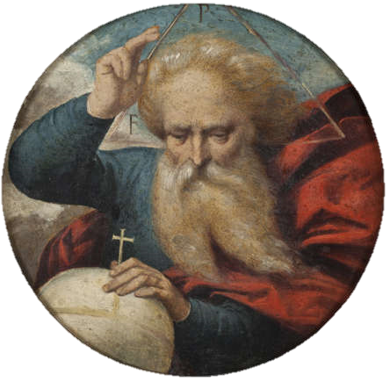
God is omniscient
Indeed, the Bible tells us that God knows everything.
Psalm 139:4
1 John 3:20
Notes:
Indeed, the Bible tells us that God knows everything. Psalm 139:4 is a good example: “For there is not a word on my tongue, But behold, O Lord, You know it altogether.”
A verse in 1 John 3:20 also tells us of God’s omniscience: “For if our heart condemns us, God is greater than our heart, and knows all things.”

Slide 4
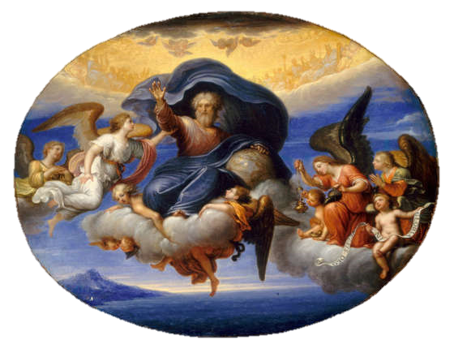
God is omnipresent
Not only does God know everything, but he is everywhere.
Proverbs 15:3
Notes:
Not only does God know everything, but he is everywhere. “The eyes of the Lord are in every place, Keeping watch on the evil and the good.” (Proverbs 15:3).

Slide 5
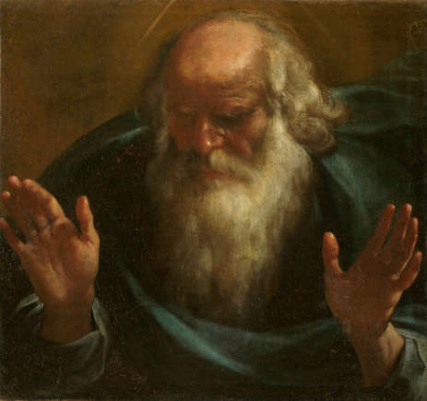
God is everlasting
God is eternal, according to Isaiah 40:28, which mentions “The everlasting God, the Lord.”
Notes:
God is eternal, according to Isaiah 40:28, which mentions “The everlasting God, the Lord.”

Slide 6
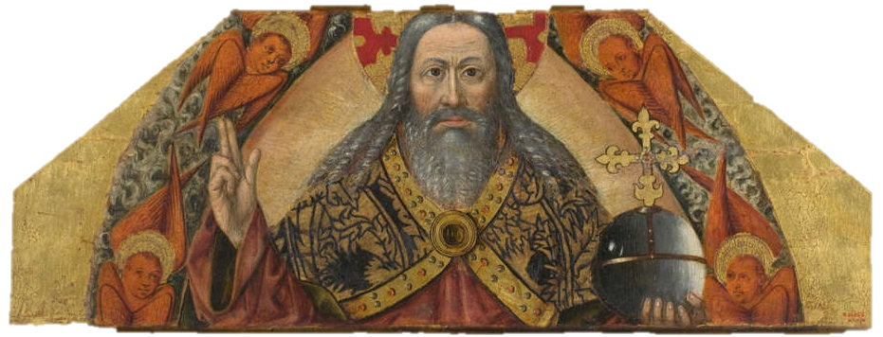
God is immutable
God doesn’t change. God himself said it, according to Malachi 3:6.
Notes:
God doesn’t change. God himself said it, according to Malachi 3:6. The passage goes: “For I am the Lord, I do not change; Therefore you are not consumed, O sons of Jacob.”

Slide 7
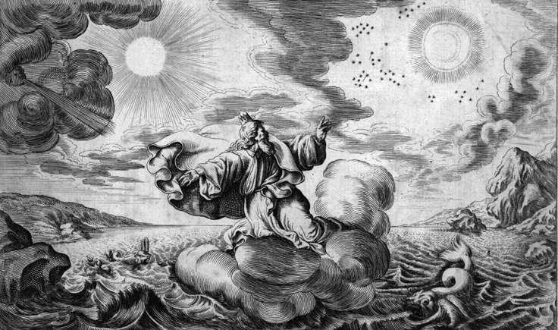
God is transcendent
The transcendence of God is a key attribute that is mentioned in the Bible. Isaiah 55:8-9 is one good example.
Notes:
The transcendence of God is a key attribute that is mentioned in the Bible. Isaiah 55:8-9 is one good example. It reads: “For My thoughts are not your thoughts, nor are your ways My ways,” says the Lord. “For as the heavens are higher than the earth, so are My ways higher than your ways, and My thoughts than your thoughts.”

Slide 8
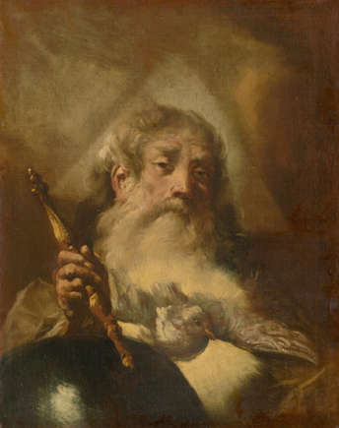
God is a creator
God created everything and his status as the creator is mentioned in the Bible multiple times.
Colossians 1:16
Notes:
God created everything and his status as the creator is mentioned in the Bible multiple times. Colossians 1:16 gives us a good summary of this specific attribute.
It reads: “For by Him all things were created that are in heaven and that are on earth, visible and invisible, whether thrones or dominions or principalities or powers. All things were created through Him and for Him.”

Slide 9
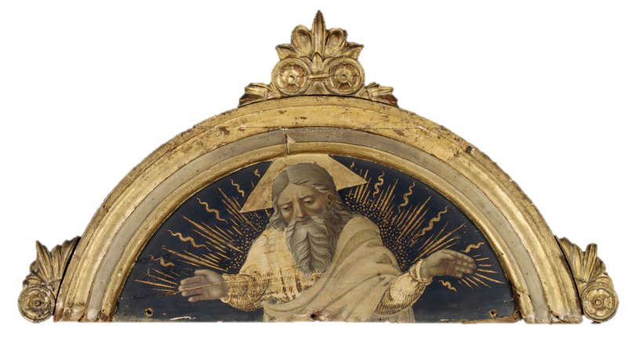
God is a savior
When it comes to salvation, God is there.
(Isaiah 45:21).
Notes:
When it comes to salvation, God is there. “Tell and bring forth your case; Yes, let them take counsel together. Who has declared this from ancient time? Who has told it from that time Have not I, the Lord? And there is no other God besides Me, a just God and a Savior; There is none besides Me.” (Isaiah 45:21).

Slide 10
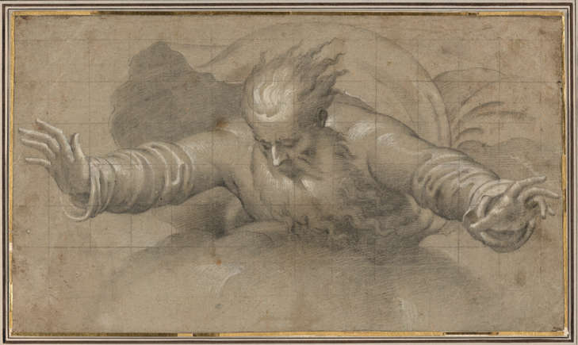
God is just
The aforementioned Bible verse also mentions that God is just. This attribute can be found in other parts of the Bible, including Deuteronomy 32:4:
Notes:
The aforementioned Bible verse also mentions that God is just. This attribute can be found in other parts of the Bible, including Deuteronomy 32:4: “He is the Rock, His work is perfect; For all His ways are justice, a God of truth and without injustice; Righteous and upright is He.”

Slide 11
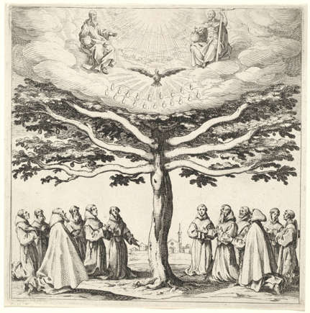
God is holy
“No one is holy like the Lord,” reads 1 Samuel 2:2. This is a pretty strong statement about God’s holiness.
Notes:
“No one is holy like the Lord,” reads 1 Samuel 2:2. The verse continues: “for there is none besides You, nor is there any rock like our God.” This is a pretty strong statement about God’s holiness.

Slide 12
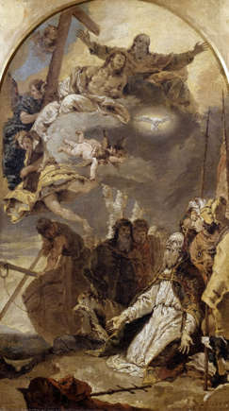
God is worthy
God is worthy “to receive glory and honor and power,” according to Revelation 4:11.
Notes:
God is worthy “to receive glory and honor and power,” according to Revelation 4:11.

Slide 13
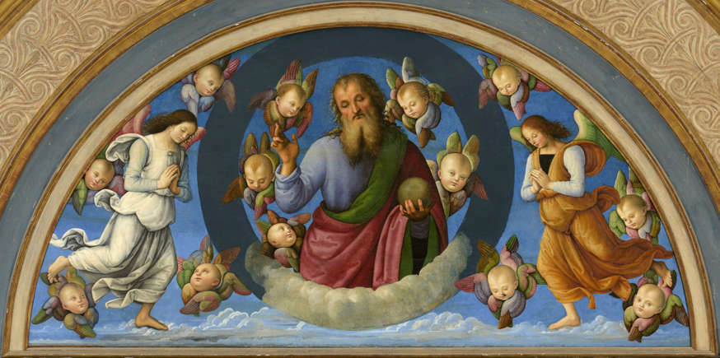
God is glorious
God’s glory is a key attribute mentioned in the holy book. This is celebrated in Isaiah 6:3 for instance.
Psalm 8:1
Notes:
God’s glory is a key attribute mentioned in the holy book. This is celebrated in Isaiah 6:3 for instance. It reads “Holy, holy, holy is the Lord of hosts; The whole earth is full of His glory!”
Psalm 8:1 is also a good example: “O Lord, our Lord, How excellent is Your name in all the earth, Who have set Your glory above the heavens!”

Slide 14
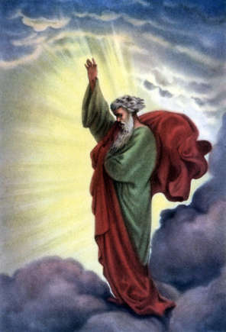
God is wise and strong
Job 12:13 tells us how God is wise and strong: “With Him are wisdom and strength, He has counsel and understanding.”
Notes:
Job 12:13 tells us how God is wise and strong: “With Him are wisdom and strength, He has counsel and understanding.”

Slide 15
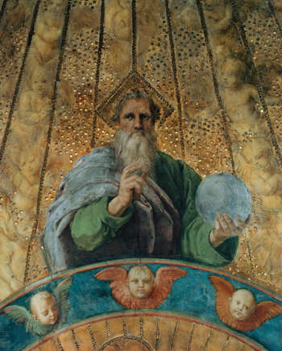
God is good
The premise that God is good is found in the Bible. One good example is Psalm 34:8.
Notes:
The premise that God is good is found in the Bible. One good example is Psalm 34:8, which reads: “Oh, taste and see that the Lord is good; Blessed is the man who trusts in Him.”

Slide 16
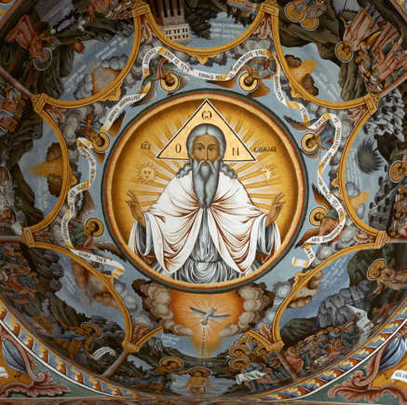
God is love
Many of us are familiar with the concept of God’s love. This is referenced in the Bible.
(1 John 4:16)
Notes:
Many of us are familiar with the concept of God’s love. This is referenced in the Bible. “And we have known and believed the love that God has for us. God is love, and he who abides in love abides in God, and God in him.” (1 John 4:16).

Slide 17
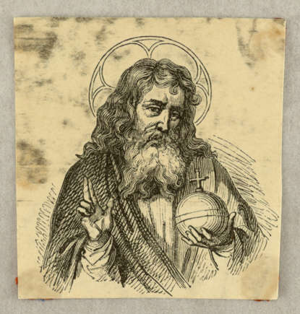
God is merciful
God’s mercy is an attribute many believers appreciate. Ephesians 2:4 explains: "But God, who is rich in mercy, because of His great love with which He loved us.”
Notes:
God’s mercy is an attribute many believers appreciate. Ephesians 2:4 explains: "But God, who is rich in mercy, because of His great love with which He loved us.”

Slide 18
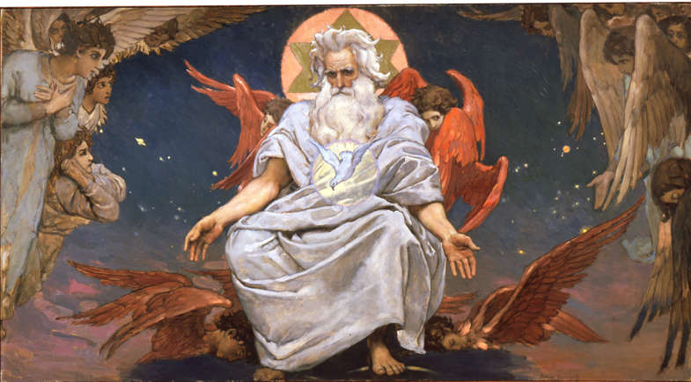
God is faithful
This important attribute is described in 1 Corinthians 1:9, which reads: “God is faithful, by whom you were called into the fellowship of His Son, Jesus Christ our Lord.”
Notes:
This important attribute is described in 1 Corinthians 1:9, which reads: “God is faithful, by whom you were called into the fellowship of His Son, Jesus Christ our Lord.”

Slide 19
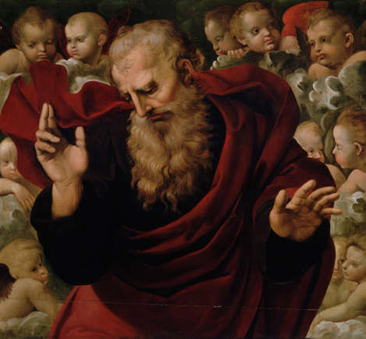
God is compassionate and gracious
Psalm 86:15 makes reference to these two attributes: “But You, O Lord, are a God full of compassion, and gracious, long suffering and abundant in mercy and truth.
Notes:
Psalm 86:15 makes reference to these two attributes: “But You, O Lord, are a God full of compassion, and gracious, long suffering and abundant in mercy and truth.

Slide 20
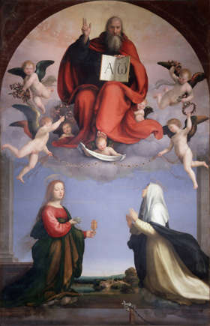
God is a healer
God heals. There are multiple examples of this in the numerous miracles mentioned in the Bible. (Exodus 15:26)
Notes:
God heals. There are multiple examples of this in the numerous miracles mentioned in the Bible. “If you diligently heed the voice of the Lord your God and do what is right in His sight, give ear to His commandments and keep all His statutes, I will put none of the diseases on you which I have brought on the Egyptians. For I am the Lord who heals you.” (Exodus 15:26).

Slide 21
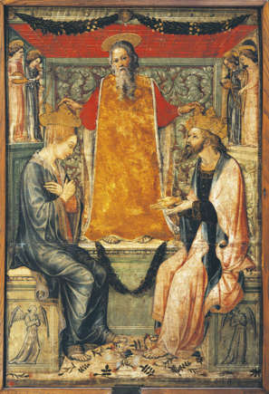
God is a provider
God provides his people with everything they need.
(Philippians 4:19)
Notes:
God provides his people with everything they need. “And my God shall supply all your need according to His riches in glory by Christ Jesus.” (Philippians 4:19).

Slide 22
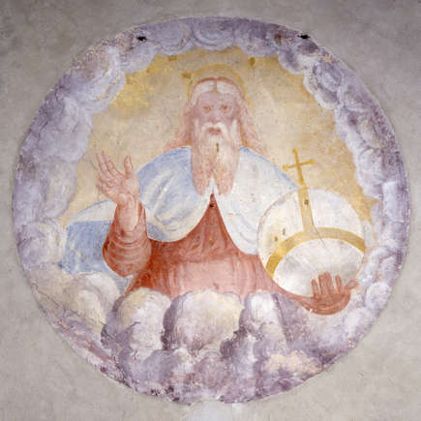
God is truthful
"God is not a man," according to Numbers 23:19, so he doesn't lie. Whatever he says he is and does, is the truth.
Notes:
"God is not a man," according to Numbers 23:19, so he doesn't lie. Whatever he says he is and does, is the truth.

Slide 23
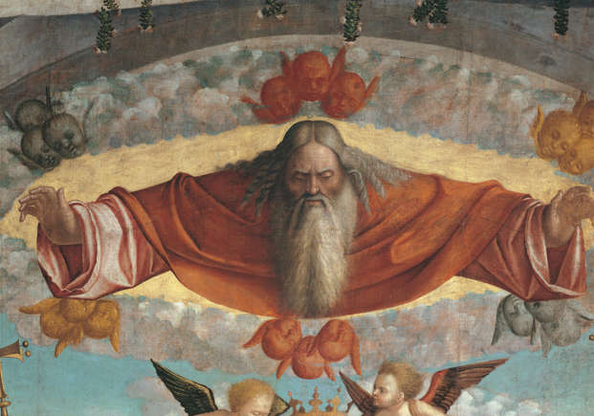
God is righteous
Being morally right is one of God’s most popular attributes. “The Lord is righteous in all His ways, Gracious in all His works.” (Psalm 145:17).
Notes:
Being morally right is one of God’s most popular attributes. “The Lord is righteous in all His ways, Gracious in all His works.” (Psalm 145:17).

Slide 24
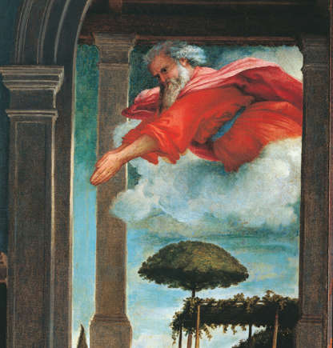
God is just
Deuteronomy 32:4 tells us that “He is the Rock, His work is perfect; For all His ways are justice, a God of truth and without injustice; Righteous and upright is He.”
Notes:
Deuteronomy 32:4 tells us that “He is the Rock, His work is perfect; For all His ways are justice, a God of truth and without injustice; Righteous and upright is He.”

Slide 25
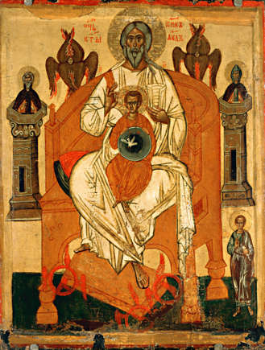
God is self-sufficient
This attribute can be found in John 5:26, which reads: “For as the Father has life in Himself, so He has granted the Son to have life in Himself.”
Notes:
This attribute can be found in John 5:26, which reads: “For as the Father has life in Himself, so He has granted the Son to have life in Himself.”

Slide 26
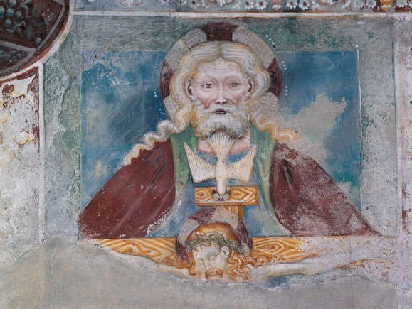
God is jealous
God is jealous in the sense that he doesn’t want us to worship other gods. (Exodus 34:14)
Notes:
God is jealous in the sense that he doesn’t want us to worship other gods. Exodus 34:14 reads: “Or you shall worship no other god, for the Lord, whose name is Jealous, is a jealous God.”

Slide 27
Sources
Sources: (Bible Study Tools) (Equation of Hope)
God’s main attributes (according to the Bible)
https://www.msn.com/en-in/entertainment/hollywood/god-s-main-attributes-according-to-the-bible/ss-AA1twSqf (December 05, 2024)

Slide 28


Deepagam
Don Bosco Catechetical Center, The Citadel
No. 45, Landons Road, Kilpauk, Chennai – Tamil Nadu, 600010, INDIA
Email: web.Deepagam.inm@gmail.com
Website: https://deepagam.com
Facebook: @deepagamdonbosco.deepagamdonbosco
Twitter (X): @deepagamdb

